Slide 1
Fundamentals of CRE
Chemical Reaction Engineering
By
Dr Salah N. Farhan
Senior lecturer. Chem. Eng. Dept.
College of Engineering
University of Diyala
Salah N. Farhan College of Engineering Diyala University

Slide 2
Fundamentals of CRE
Chapter 14: Pseudo Steady State Hypothesis (PSSH)
Salah N. Farhan College of Engineering Diyala University

Slide 3
Pseudo Steady State Hypothesis (PSSH)
Net rate of reaction of active intermediates is zero
Hall of Fame Reaction: 2NO +O₂→ 2NO₂
Introduction to Enzyme Kinetics
Begin non-Isothermal reactor design

Slide 4
Active Intermediates and PSSH
An active intermediate is a molecule that is in a highly energetic and reactive state It is short lived as it disappears virtually as fast as it is formed. That is, the net rate of reaction of an active intermediate, A*, is zero.
The assumption that the net rate of reaction is zero is called the Pseudo Steady State Hypothesis (PSSH)

Slide 5
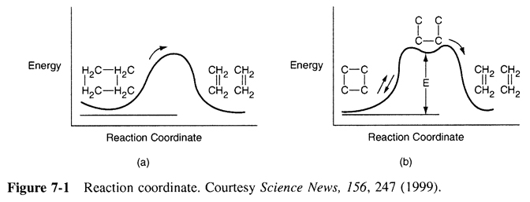
Active Intermediates and PSSH

Slide 6
Example
The rate law for the reaction
is found from experiment to be
How did this rate law come about? Suggest a mechanism consistent with the rate law.

Slide 7
Example
For reactions with active intermediates, the reaction coordinated now has trough in it and the active intermediate, A*, sits in this trough

Slide 8
Example - Solution

Slide 9
Rate Laws:
k₃ is defined w.r.t. A*
Reaction (1) (1)
Reaction (2) (2)
Reaction (3) (3)
But C*_{A} cannot be measured since it is so small
Relative Rates:

Slide 10
Net Rates: Rate of Formation of Product
(4)
Pseudo Steady State Hypothesis r*_{A} = 0
(5)
(6)
Solving for

Slide 11
Substituting for in Equation (4) the rate of formation of B is
(8)
Relative rates overall
(9)

Slide 12
For high concentrations of A, we can neglect in the denominator with respect to
and the rate law becomes
(10)
(apparent first order)

Slide 13
For low concentrations of A, we can neglect in the denominator with respect to k₃.
and the rate law becomes
(11)
(apparent second order)
Dividing by k₃ and letting k’=k₂/k₃ and k=k₁ we have the rate law we were asked to derive
(12)

Slide 14
Active Intermediates
Why do so many reactions follow elementary rate laws?
What about

Slide 15
Active Intermediates/Free Radicals and PSSH
Hall of Fame Reaction
The reaction: 2NO +O₂→ 2NO₂
has an elementary rate law
However… Look what happens to the rate as the temperature increases:
-r_{NO2}
T

Slide 16
Why does the rate law decrease with increasing temperature?
Mechanism:
(1)
(2)
(3)
Write rate of formation of product r_{NO2}
Note: k₃ is defined w.r.t. NO₃*

Slide 17
Define k with respect to NO₃*
Assume that all reactions are elementary reactions, such that:

Slide 18
The net reaction rate for NO₃* is the sum of the individual reaction rates for NO₃*:

Slide 19
Pseudo Steady State Hypothesis (PSSH)
The PSSH assumes that the net rate of species A* (in this case NO₃*) is zero.

Slide 20
Pseudo Steady State Hypothesis (PSSH)
$$[NO_{3}^{∗}]=\frac{k_{1}\left[NO\right]\left[O_{2}\right]}{k_{2}+k_{3}\left[NO\right]}$$
$$r_{NO_{2}}=2\frac{k_{1}k_{3}{\left[NO\right]}^{2}\left[O_{2}\right]}{k_{2}+k_{3}\left[NO\right]}$$

Slide 21
Pseudo Steady State Hypothesis (PSSH)
This result shows why the rate decreases as temperature increases.
-r_{NO2}
T

Slide 22
Enzymatic Reactions
Michealis-Menten Kinetics
Lineweaver-Burk Plot
Enzyme Inhibition
Competitive
Uncompetitive
Non-Competitive

Slide 23
Active Intermediates and PSSH
Review Last Lecture

Slide 24
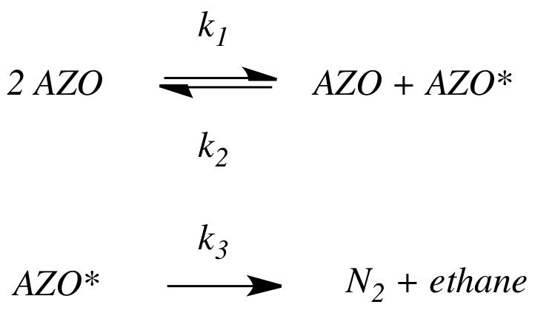
Active Intermediates and PSSH
Review Last Lecture
1.In the PSSH, we set the rate of formation of the active intermediates equal to zero. If the active intermediate A* is involved in m different reactions, we set it to:
2. The azomethane (AZO) decomposition mechanism is
By applying the PSSH to AZO*, we show the rate law, which exhibits first-order dependence with respect to AZO at high AZO concentrations and second-order dependence with respect to AZO at low AZO concentrations.

Slide 25
Enzymes
Michaelis-Menten Kinetics
Enzymes are protein-like substances with catalytic properties.
Enzyme Unease [From Biochemistry, 3/E by Stryer, copywrited 1988 by Lubert Stryer. Used with permission of W.H. Freeman and Company.]

Slide 26
Enzymes
Enzymes provide a pathway for the substrate to proceed at a faster rate. The substrate, S, reacts to form a product P.
Slow
S
P
Fast
A given enzyme can only catalyze only one reaction. Example, Urea is decomposed by the enzyme urease.

Slide 27
Enzymes - Urease
A given enzyme can only catalyze only one reaction. Urea is decomposed by the enzyme urease, as shown below.
The corresponding mechanism is:

Slide 28
Enzymes - Michaelis-Menten Kinetics

Slide 29
Enzymes - Michaelis-Menten Kinetics

Slide 30
Enzymes - Michaelis-Menten Kinetics
V_{max}=k_{cat}E_{t}
Turnover Number: k_{cat}
Number of substrate molecules (moles) converted to product in a given time (s) on a single enzyme molecule (molecules/molecule/time)
For the reaction:
k_{cat}
H₂O₂ + E →H₂O + O + E
40,000,000 molecules of H₂O₂ converted to product per second on a single enzyme molecule.

Slide 31
Enzymes - Michaelis-Menten Kinetics
Michaelis-Menten Equation
(Michaelis-Menten plot)
V_{max}
Solving:
K_{M}=S_{1/2}
therefore K_{M} is the concentration at which the rate is half the maximum rate.
-r_{s}
S_{1/2}
C_{S}

Slide 32
Enzymes - Michaelis-Menten Kinetics
Inverting yields:
Lineweaver-Burk Plot
1/-r_{S}
slope = K_{M}/V_{max}
1/V_{max}
1/S

Slide 33
Types of Enzyme Inhibition
Competitive
Uncompetitive
Non-competitive

Slide 34
Competitive Inhibition

Slide 35
Competitive Inhibition
1) Mechanisms:

Slide 36
Competitive Inhibition
2) Rate Laws:

Slide 37
Competitive Inhibition

Slide 38
Competitive Inhibition
From before (no competition):
Increasing C_{I}
Competitive
No Inhibition
Competitive
Intercept does not change, slope increases as inhibitor concentration increases

Slide 39
Uncompetitive Inhibition

Slide 40
Uncompetitive Inhibition
Inhibition only has affinity for enzyme-substrate complex
Developing the rate law:
(1)
(2)

Slide 41
Adding (1) and (2)
Uncompetitive Inhibition
From (2)

Slide 42
Uncompetitive Inhibition
Total enzyme

Slide 43
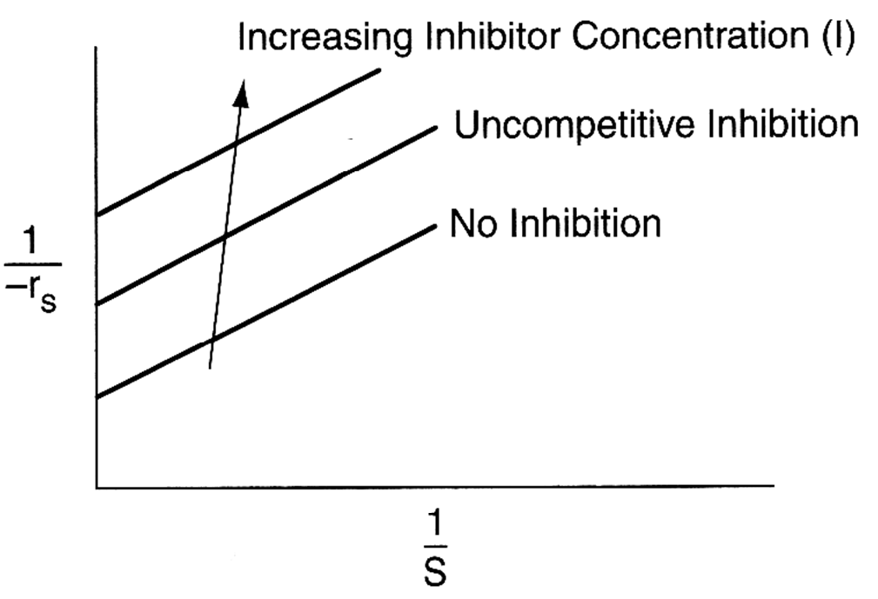
Uncompetitive Inhibition
Slope remains the same but intercept changes as inhibitor concentration is increased
Lineweaver-Burk Plot for uncompetitive inhibition

Slide 44
Non-competitive Inhibition

Slide 45
Non-competitive Inhibition
E + S E·S P + E
(inactive)I.E + S I.E.S (inactive)
+I
-I
-I
+I
Increasing I
No Inhibition
Both slope and intercept changes

Slide 46
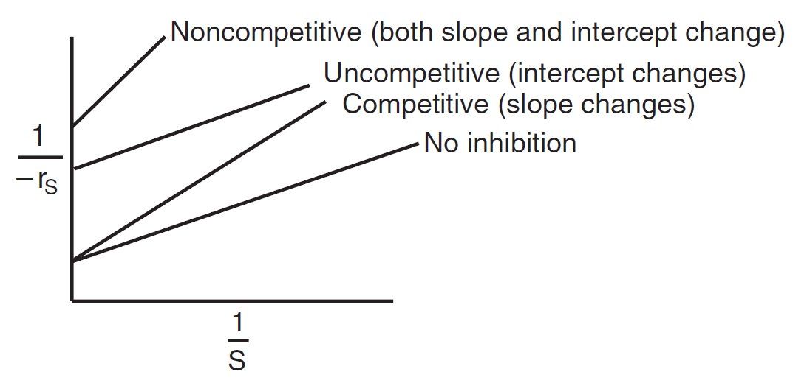
Summary: Types of Enzyme Inhibition
Lineweaver–Burk plots for three types of enzyme inhibition.

Slide 47
Fundamentals of CRE
Salah N. Farhan College of Engineering Diyala University

Slide 48
Fundamentals of CRE
Salah N. Farhan College of Engineering Diyala University

Slide 49
Fundamentals of CRE
Salah N. Farhan College of Engineering Diyala University

Slide 50
Fundamentals of CRE
Salah N. Farhan College of Engineering Diyala University

Slide 51
Fundamentals of CRE
Salah N. Farhan College of Engineering Diyala University

Slide 52
Fundamentals of CRE
Salah N. Farhan College of Engineering Diyala University

Slide 53
Fundamentals of CRE
Salah N. Farhan College of Engineering Diyala University

Slide 54
Fundamentals of CRE
Salah N. Farhan College of Engineering Diyala University

Slide 55
Fundamentals of CRE
Salah N. Farhan College of Engineering Diyala University

